Slide 1
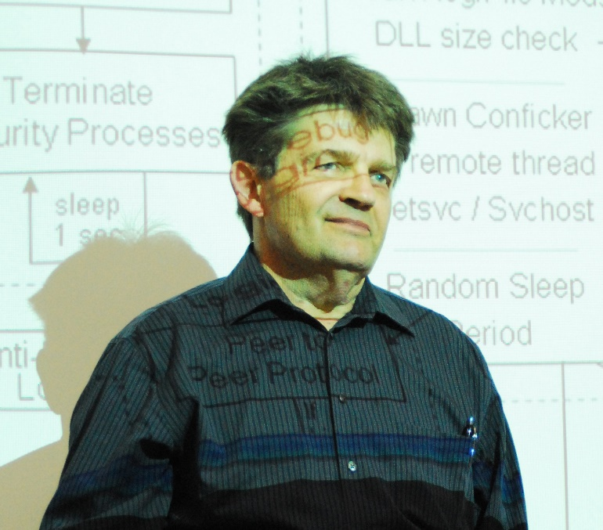
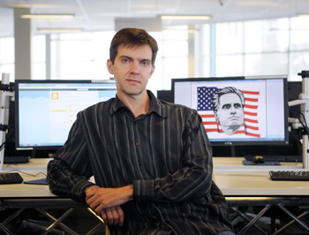
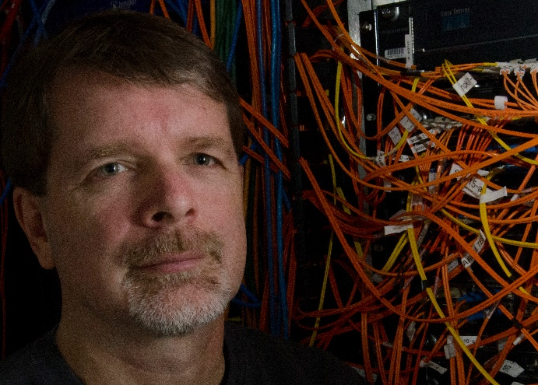
People who are teaching malware
Notes:
Malware has now placed us into a position where we need to consider other alternatives. A few people of education have realized this and have introduced new methods of learning in the fields of computer science. Their main goals are common in nature. To teach how malware works so that can better prepare our future professionals. Let’s take a look at them now…

Slide 2

People who are teaching malware
Name: | George Ledin
Occupation: | Computer Science Professor
Teaching Location: | Sonoma State University in Rohnert Park, California
Course Name: | Computer Security and Malware
Notes:
George Ledin, a professor in the computer science field who is a trailblazer on malware design and defense education. His course is called “Computer Security and Malware“at Sonoma State University in California. He has been subject to the media for some time due to his involvement with the course. Antivirus companies have shunned him calling “him” the nuisance instead of the malware that they aim to prevent. On the other side, Ledin believes that antivirus products are of no worth whatsoever.

Slide 3

People who are teaching malware
Name: | Dr. John Sullins
Occupation: | Computer Science Professor (Assistant )
Teaching Location: | Sonoma State University in Rohnert Park, California
Course Name: | Computer Security and Malware
Notes:
Dr. John Sullins, his responsibilities lie in teaching computer ethics to classes alongside Mr. Ledin. He specializes in philosophical issues of artificial intelligence/robotics, engineering ethics, philosophy of technology, and more. He is also a certified Military Master at Arms and winner of the 2011 Herbert A. Simon Award. Professor Ledin and Dr. Sullins agreed before beginning the curriculum that ethics would need to be stressed given the circumstances of the content.

Slide 4
People who are teaching malware
Name: | John Aycock
Occupation: | Computer Science Professor
Teaching Location: | University of Calgary in Calgary, Alberta
Course Name: | Spam and Spyware
Notes:
Professor John Aycock teaches a course developed in 2005 called “Spam and Spyware” that we will highlight later on. At the time of its development it was the only one known in existence. Similar to Ledin’s theory on learning the development process of malicious code, Professor Aycock believes the more that is known about malware, the better prepared we will be to defend against it. Also he stresses that places of higher learning should be more responsible for handing out education on this subject matter as it is very difficult to find specific resources alone.

Slide 5

Importance on Ethics
With great power there
must also come ...
great responsibility!
STAN LEE, Amazing
Fantasy #15, Aug. 1962
Notes:
Before we dive into the malware specific courses offered by some of these professors, we will look at the side requirements that are essential to them. Ethics. Dangerous knowledge is how Dr.John Sullins describes the act of malware programming and in cases where it’s taught requires special consideration on ethics. He alone is responsible for embedding concepts of right and wrong into the student minds that attend Professor Ledin’s computer science program. Learning the art of malware in his words require firewalls of both technical and moral nature.

Slide 6
Importance on Ethics
Why do we need to learn about ethics?
Temptation
Power Hungry
Corruption
Curiosity
Persuasion
Notes:
Why is this necessary you might ask? Consider from the brief history we looked at and what capabilities some of the malware possessed. If you were taught a method on how to bypass every single antivirus program created, would you be tempted to create the software and utilize it for your own purposes? You may be easily swayed or become corrupt with the knowledge your given and use it for self gain. Depending on your own morals the direction is either way. In order for education to be successful with its malware teaching endeavors, ethics must reinforce the minds of students who will be planted deep in its roots.
Working with malware even for the best of intentions still requires someone to think like the developer who created it. Human nature would say the more you think like a person who developed a program to steal information or break security measures, the more your own judgement changes. A skill ethics can develop is to keep those two worlds separate in one’s own mind.

Slide 7
Importance on Ethics
Basic Concepts:
ACM Code of Conduct! “ The Prime Directive for Programmers! “
Virtues in Security:
Confidentiality, Integrity and Availability ( CIA )
Ethical Hacks:
Breaking the boundaries of computer systems.
Assessments:
Put your loyalties to the test!
Notes:
Now some example methods on how ethics are taught to students!
Basic concepts:
Starting place for students is the Association of Computing Machinery (abbr. ACM) Code of Ethics. This is a code that contains 24 crucial statements describing ethical issues a professional may come across in his or her IT career. The code uses a set of guidelines that complement the statements directing how one should proceed upon confronting an issue. Think of it as a programmers “Prime Directive “if you’re a star trek fan. There are areas that the code still may not cover completely so other theories are lectured such as utilitarianism( an ethical doctrine based on utility ), deontology( ethics dealing with duty, moral obligation and right action ), human rights, and the unified common goods approach as described by James Moor. These in turn also have their own good and bad areas so other systems are used to cover them.
Virtues in Security:
A concept taught to students are the three virtues on secure software. They are confidentiality, integrity, and availability (CIA). A particular CIA approved analogy on firewalls used to build systems is focused on as well, noting that it is questionable. This is due to the possibility of unknown perils from “inside” the system. The ethics on data level security are then discussed including the challenges that follow.
Ethical Hacks:
It’s advised that students should not just think like a goodie good but as a researcher striving to attain different methods that will work for humanity in the future. Also that defying limits and abilities of computer systems is not completely wrong. Innovation thrives on new discovery and a student may very well come across such a discovery. The main concern in the motivation of the student so concentration is applied to their virtues and personal motives. Students ultimately decide whether to take paths of good or evil based on these, and not because they choose to disregard a basic code of conduct.
Assessments:
The reason why students choose a particular method based on their morals is examined. They are tested in two ways. The first is in a classroom through discussion and contemplation and the second method uses an exam process. While working on projects that involve awkard situations, students will be required to provide their own ethical reasoning for their choices. This is extremely important within the field of malware research.

Slide 8

Malware Course Outline
“The goal is for students to use their knowledge of the “dark side” of programming to build future computer systems that are better equipped to guard against and even combat these malicious programs.”
- Professor George Ledin
Notes:
Now that we have ethics covered we can take a look at the guts of one course being offered by Professor Aycock with the University of Calgary. The courses taught by Professor Aycock and Ledin aim for the similar goals of advancing knowledge on malware to better defend against it. In the words of Professor Ledin:
“The goal is for students to use their knowledge of the “dark side” of programming to build future computer systems that are better equipped to guard against and even combat these malicious programs.”

Slide 9

Malware Course Outline
Course Name: | Spam and Spyware
Prerequisite(s): | Computer Science 313 and 457 and consent of the Department.
Description | Spam and other unsolicited bulk electronic communication, and spyware. Legal and ethical issues. Countermeasures and related security problems. Course Hours: H(3-0)
Notes:
Here is a short description of the Spam and Spyware course offered at the University of Calgary. There are many parts to this course so we very briefly summarize each part and what it entails. We then take a look at the assignments that a student would be required to complete.
Before we continue further here is a short video with Professor Aycock speaking about his course…
PLAY VIDEO HERE

Slide 10
Malware Course Outline
Notes:
Here we have the course divided into slices shown on the pie graph. We will go through the slices with you now.
Introduction (3% PORTION)
( INVOLVES: Laboratory protocol, Legal Agreements, Professionalism )
Lab Protocol is about behavior in the lab. Applied to students, teachers and anyone involved in its maintenance. Treatment of the lab is like a biohazard area. Legal Agreements are signed by the students. Professionalism is included due to imagery that is found in the same environments of spam and spyware. Students are warned ahead of time to deal with it appropriately.
Definitions of spam and spyware (3% PORTION)
What constitutes spam and spyware. An overlook at all software to see if it would fall into the category. Official definitions are supplied later.
Ethics (8% PORTION)
( INVOLVES: General ethical theories, recognizing ethical problems, ethical decision making, sample ethical problems, professional codes of ethics and conduct, ACM code of Conduct, IEEE, Canadian Marketing Association )
It’s assumed that students have little to no training in ethics. Start with general ethical theories. Progresses into more specialized codes. A written ethics assignment is completed.
Spam and spyware law (11% PORTION)
( INVOLVES: Canada, Australia, United States )
Laws change rapidly. Examine existing and future legislation. Any cases of breaking laws are noted. Laws and ethics are presented prior to any programming. This ensures a more secure environment by bringing attention to students on their possible actions.
Spyware (23% PORTION, LARGEST)
Covers history, anti-virus and anti-spyware vendors, why it exists, how it gets onto a computer, spyware capabilities and countermeasures, keylogging defenses, startup hooks, hiding and forms of obfuscation, and much more
Phishing ( 15% PORTION )
Teaches history, social engineering, specialized forms, url tricks, pharming methods, infrastructure for phishing, anti-phishing techniques, and much more
Fraud (4% PORTION)
Advance fee fraud (aka 419 scams), various types of online scams and money laundering
Email (7% PORTION)
Involves mail system architecture, routing , DNS, SMTP transactions and mail envelopes and headers
Spam (12% PORTION)
Primer on spam while using real life examples, amassing email addresses, anti-harvesting techniques and harvester countermeasures, cleaning and verifying email lists, bulk email software techniques, open relays, open proxies, zombies and much more
Anti-Spam (15% PORTION)
Manual spam tracking methods, white and grey listing, tarpits, proof-of-work systems, sender policy framework, filter-evasion used by spammers and much more

Slide 11
Malware Course Outline
ONE ETHICS ASSIGNMENT AND FIVE PROGRAMMING ASSIGNMENTS IN A SECURE LABRATORY
Ethical Assignment
Spyware Offensive
Spware Defensive
Spam Offensive
Spam Defensive
Notes:
So now we have gone through the main segments on the course. There are also five assignments that are part of the Spam and Spyware course taught by Professor Aycock. One of which is an ethics assignment that we touched on a little and is completed prior to the four that are programming based. So starting with…
Assignment 1: Ethics Assignment
A written assignment completed by the student on ethics after the ethics portion of the course is taken.
Assignment 2: spyware/offensive.
Writing spyware that installs a startup hook( basically starts when the operating systems turns on ), changes the browser start page, and performs keylogging. Keylogging is directed at the capture of the username and password used in the web browser to access a ﬁctitious bank’s web site.
Assignment 3: spyware/defensive.
Students exchange their spyware from the previous assignment. They then develop anti-spyware software that accurately detects, identiﬁys, and removes all spyware samples.
Assignment 4: spam/offensive.
Writing bulk mailing software that delivers messages directly to an SMTP server, optionally routing through an open proxy. Because laboratory constraints preclude students from sending a message to multiple recipients in any meaningful way, students instead sent multiple messages to one recipient. Spam and ham corpora (a subset of SpamAssassin’s structured set of texts for testing) are supplied for the students to transmit.
Assignment 5: spam/defensive.
Once the email is delivered to some lucky recipient from the prior assignment, students develop a spam ﬁlter that sorts the recipient’s mailbox into spam and ham messages as accurately as possible.

Slide 12
Much detail is placed into both courses. [ LEAD INTO CONCLUSION FROM HERE ]
Notes:
Much detail is placed into the course provided at the University of Calgary. So now that you have an idea of what knowledge is gained, where do you go from here? What does the future hold for someone with these unique abilities to counteract malicious software? How will this ever help humanity?

